Slide 1
Customer Analysis
Yingjie LIU, Quan GU, Ying LAI

Slide 2
Introduction
Customer Analysis
Datasets
Goals
Supervised learning: Customer Loyalty Classification
Unsupervised learning：(Additional) Customer Portrait Analysis

Slide 3
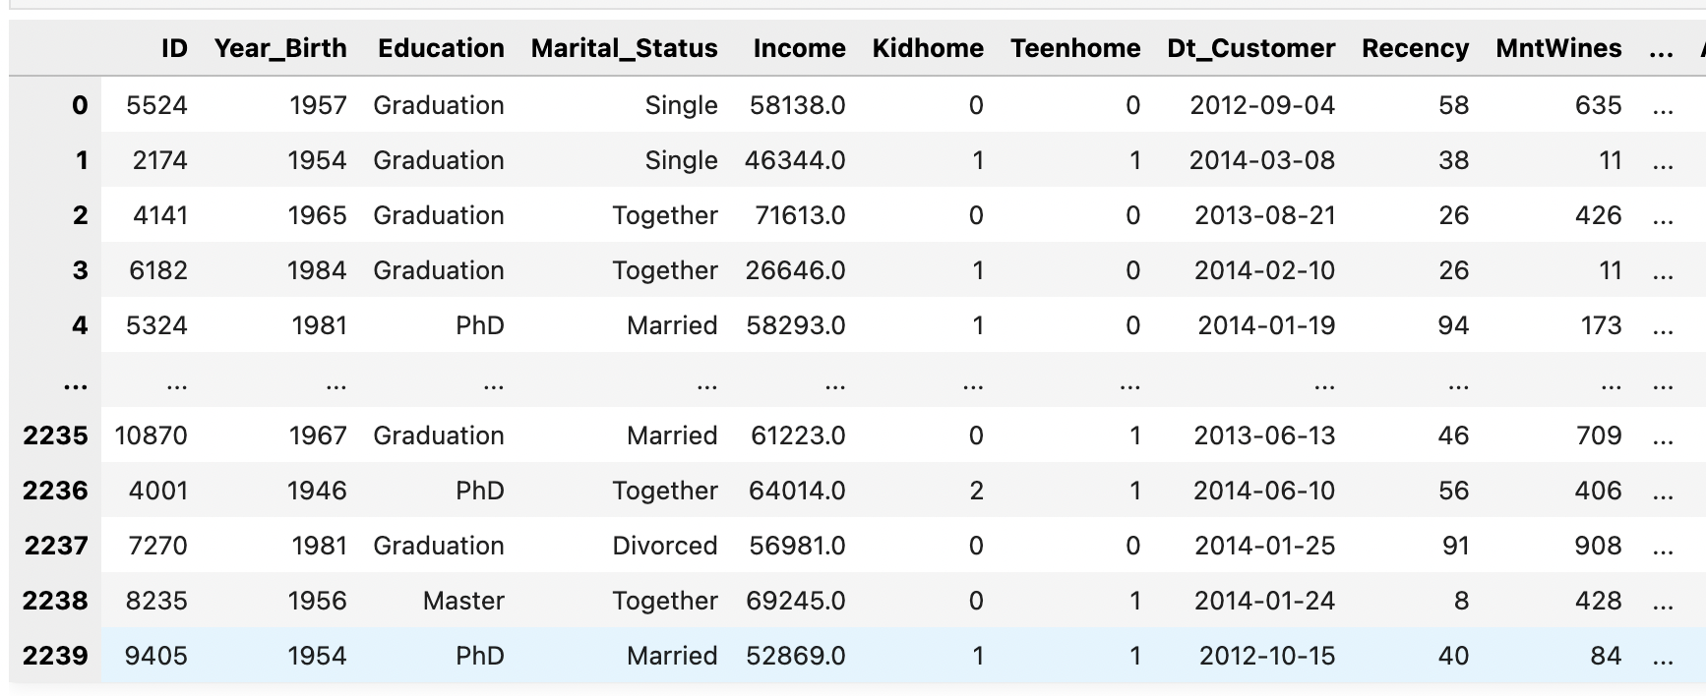
Datasets
Customer Analysis
Notes:
可以说一下几行几列，我注意到又加5列，这一部分可以看一下要不要说（说的话请在预处理当中说）

Slide 4
Goals
Customer Analysis
1. Supervised learning
Customers loyalty analysis
target attribute: Customer_Lifetime_Value
2. Unsupervised learning
Customers Classification
for sales forecasting
predict the purchasing behavior of different groups, facilitate better planning and optimization of sales strategies
-> Both are classification

Slide 5
Pre-progress
Customer Analysis
Fill missing values
Explore the datasets
Correlations between attributes
Notes:
Correlations between attributes这一部分图片太大，放上来显得太小，我没有加入，但是可以根据图，简单说两句。缺失值那里请说明用的众数（mode）。标准化的部分说一下，有监督和无监督都使用了标准化后的数据（如果并不是所有数据都用了标准化，可以简单收一下，哪一类值用了，哪些没用，比如quantity0-1值没用等）

Slide 6
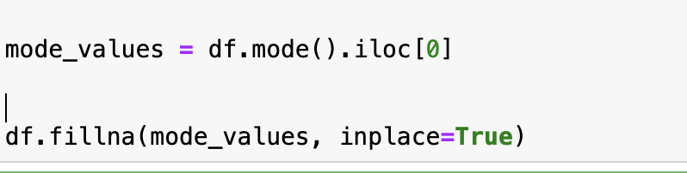
Fill missing values
Customer Analysis
Using MODE
Notes:
可以说一下几行几列，我注意到又加5列，这一部分可以看一下要不要说（说的话请在预处理当中说）

Slide 7
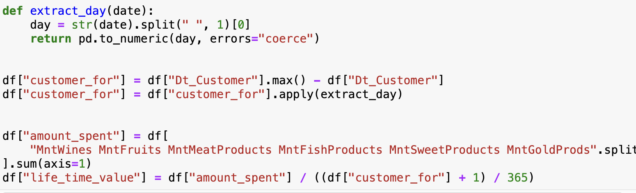
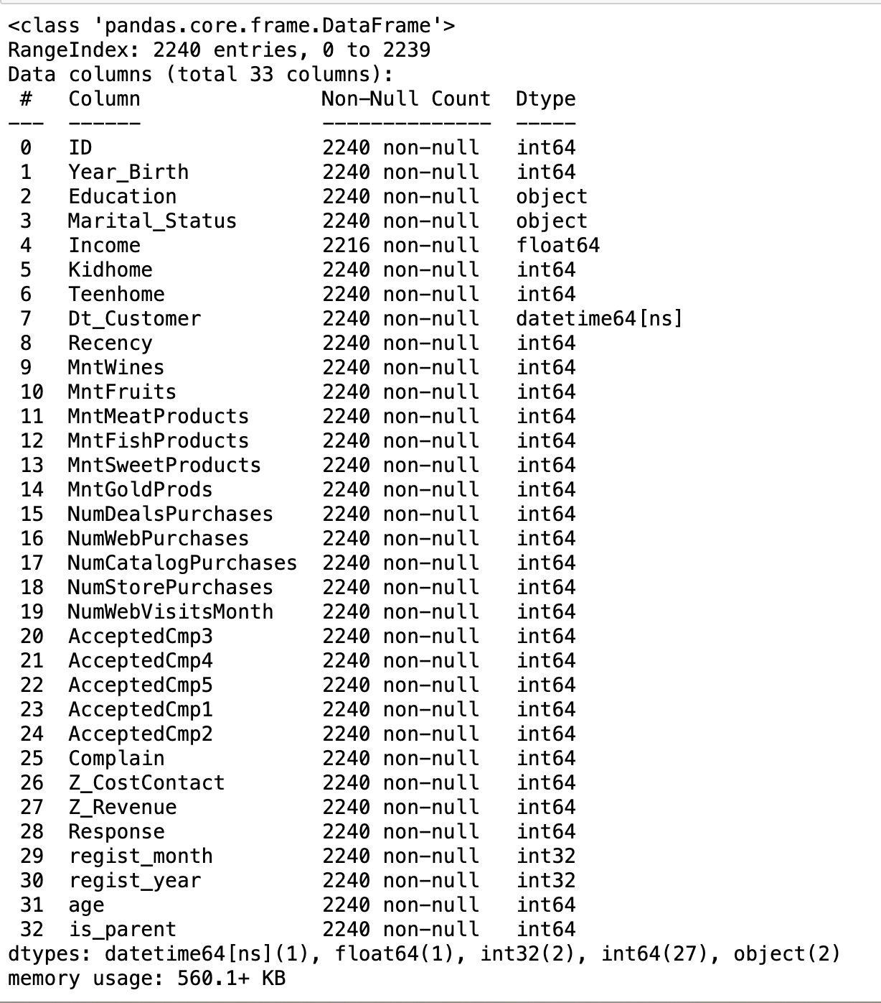
Explore the datasets
Steps:
Identified missing values in the income column, and we chose to fill them using the mode.
Performed calculations between columns involving dates to obtain meaningful numerical features.
Customer Analysis
"customer_for":
This feature shows how long each customer has been a member, calculated by subtracting their registration date from the latest registration date in the "Dt_Customer" column. It's in days.
"amount_spent":
This feature represents the total money spent by a customer on various product categories like wine, fruits, meat, fish, sweets, and gold products.
"life_time_value":
This feature reflects the total amount a customer has spent during their membership, calculated by dividing their total spending by their membership duration (in years).

Slide 8
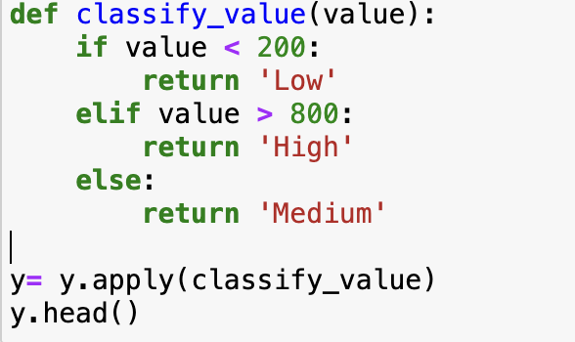
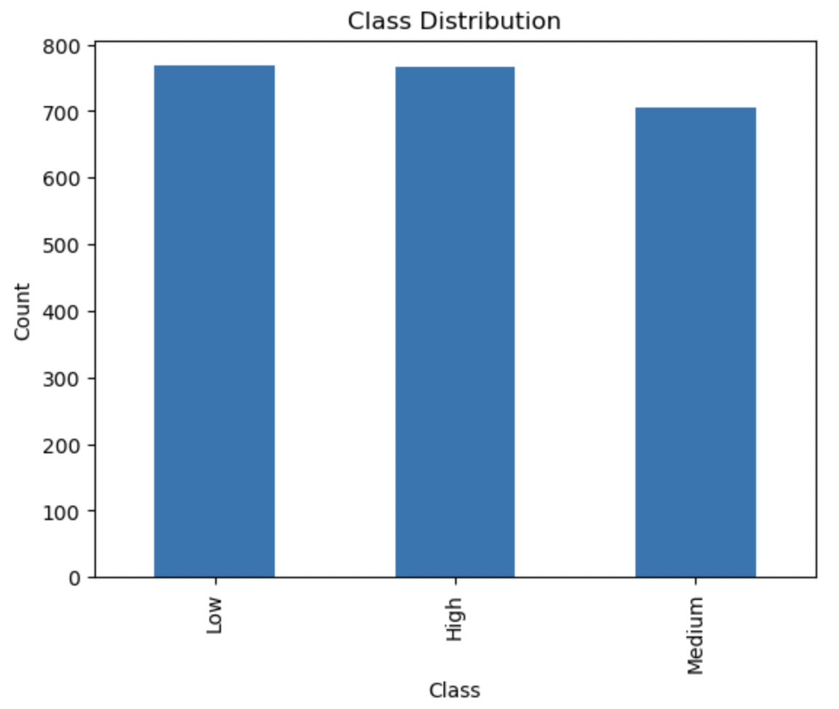
Explore the datasets
Categorized the continuous value of "life_time_value" into high-quality, medium-quality, and low-quality customers based on its magnitude. This allowed us to transform the continuous "life_time_value" into categorical labels, making it suitable for use in a classification model.
Customer Analysis
The sample sizes for all three categories are approximately equal
→ No need for oversampling or undersampling techniques to balance the dataset.

Slide 9
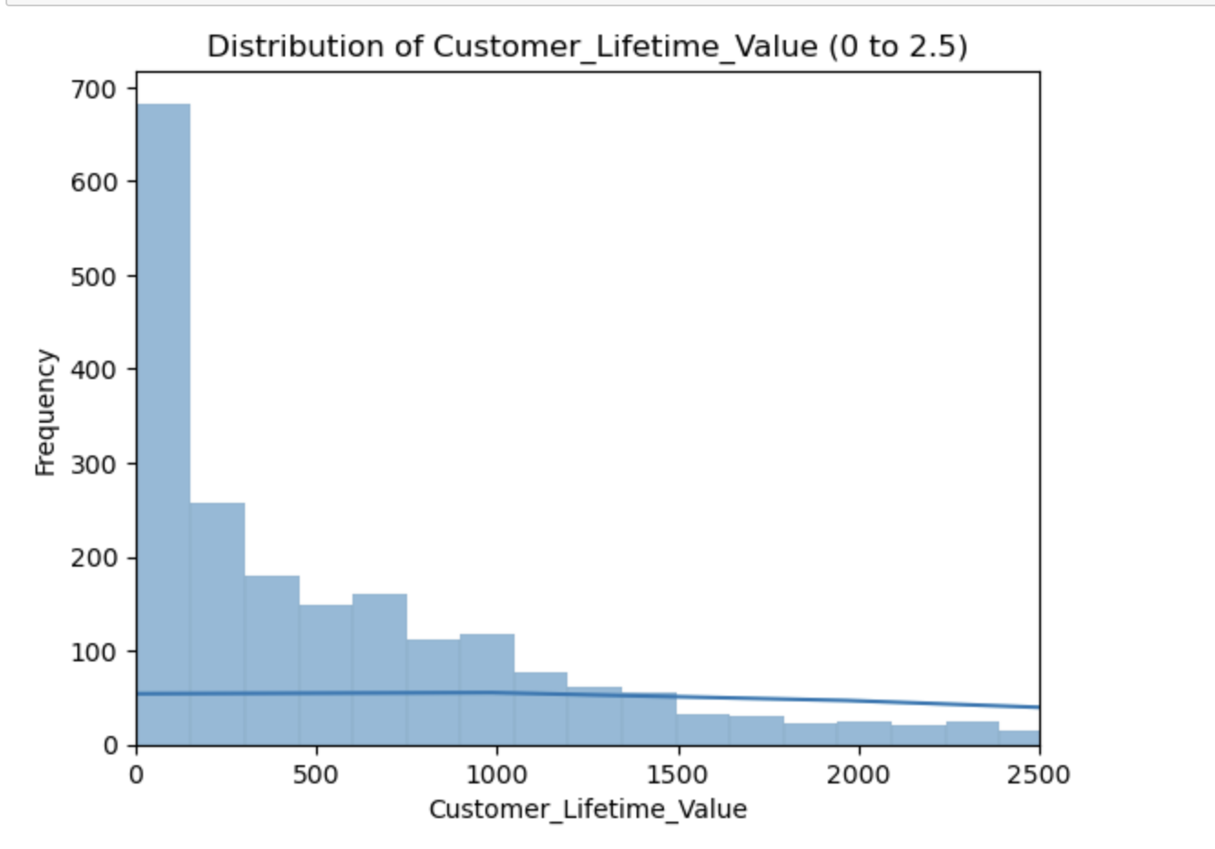
Explore the datasets
Customer Analysis
There are more customers with lower lifetime values, while customers with high lifetime values are relatively fewer

Slide 10
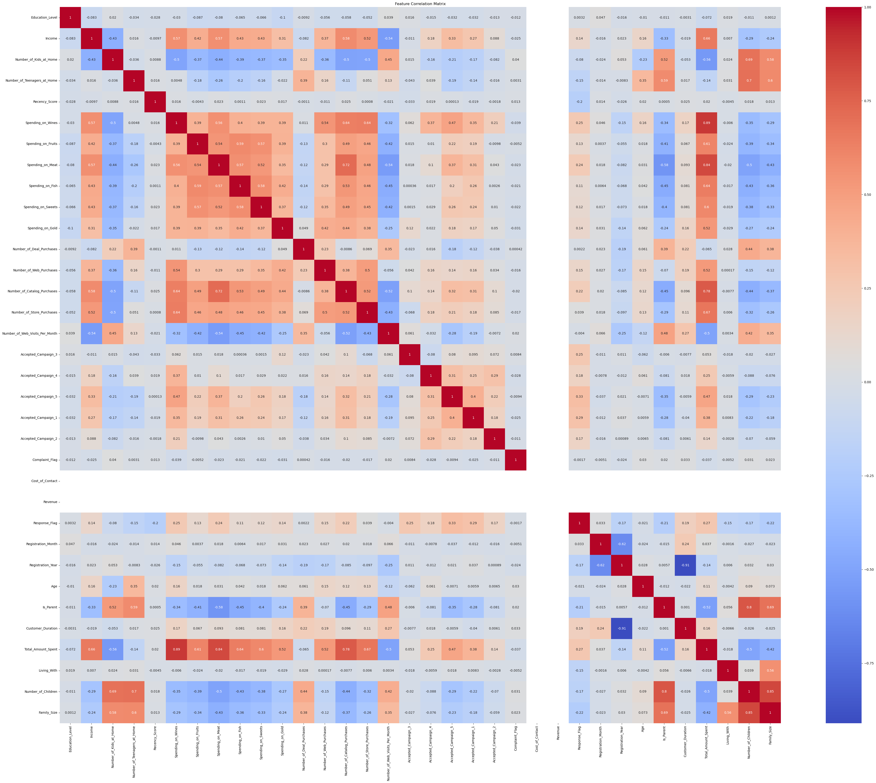
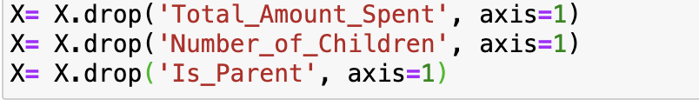
Correlations between attributes
Customer Analysis

Slide 11
Customer Analysis
Training and Results (Supervised)
Split the dataset and normalise the data on train set
Classic SVM and SVM with PCA
Cross-Validation
Experiments using more models

Slide 12
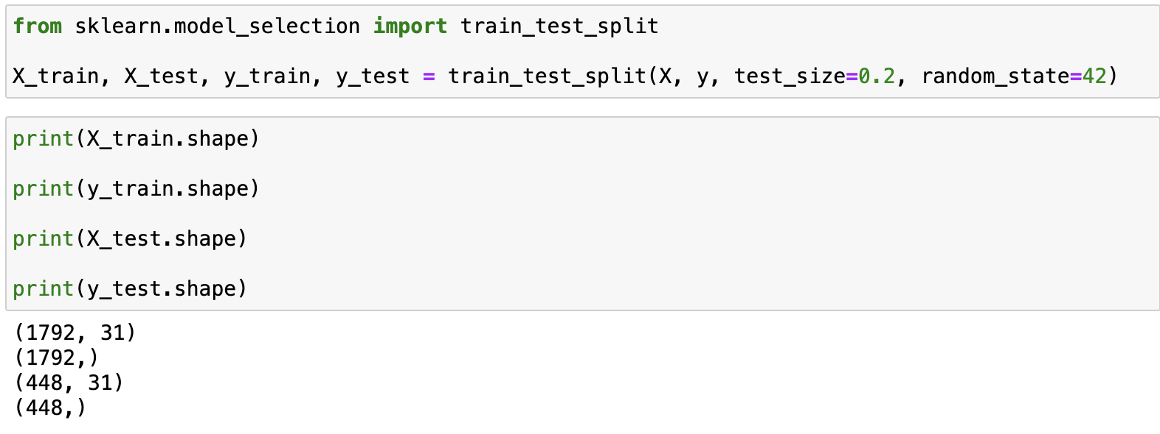
Split the dataset and normalise the data on train set
Customer Analysis
Notes:
可以说一下几行几列，我注意到又加5列，这一部分可以看一下要不要说（说的话请在预处理当中说）

Slide 13
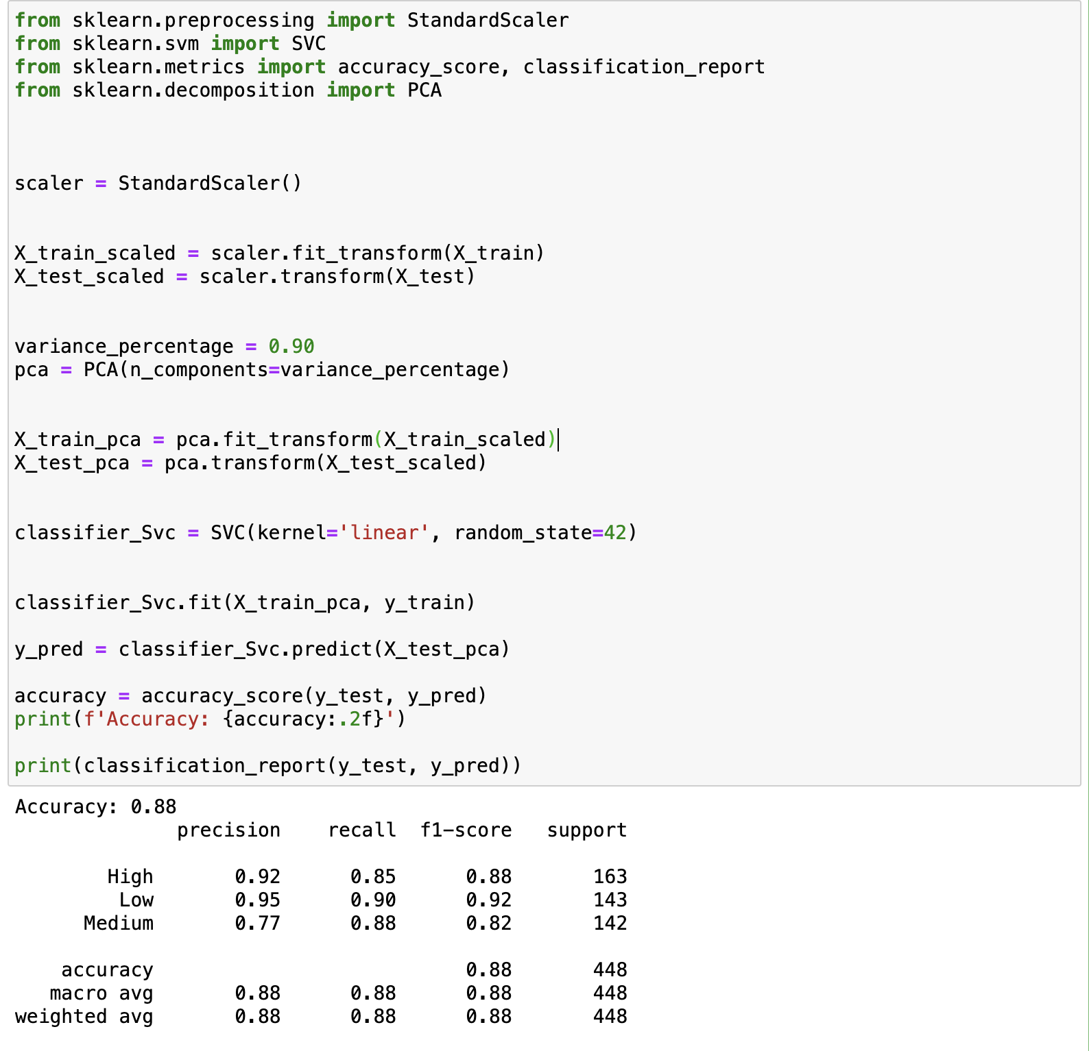
Split the dataset and normalise the data on train set
Customer Analysis
Notes:
可以说一下几行几列，我注意到又加5列，这一部分可以看一下要不要说（说的话请在预处理当中说）

Slide 14
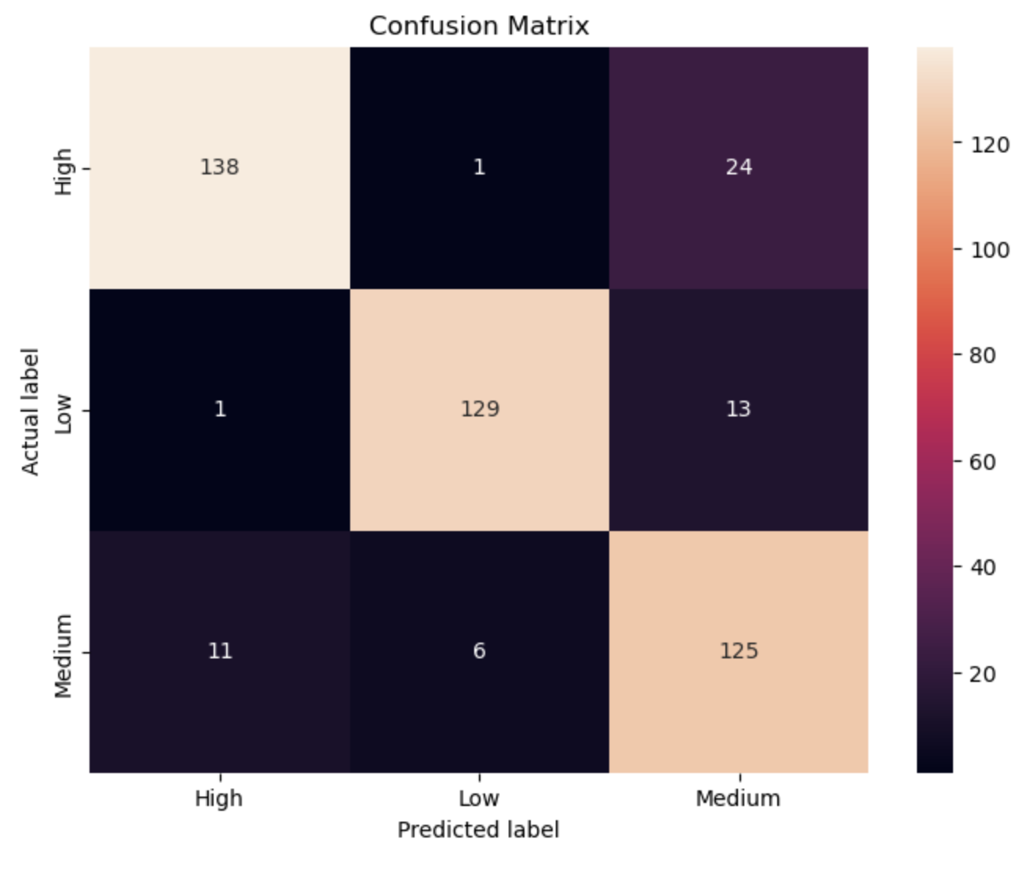
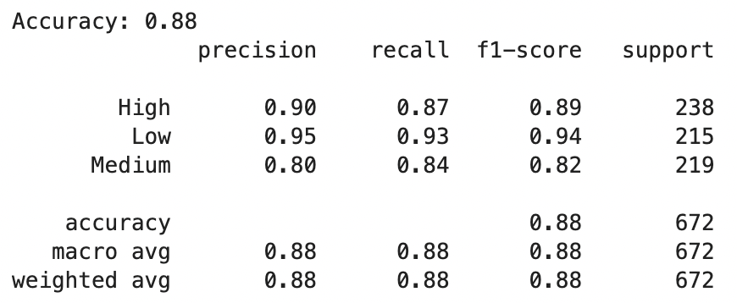
SVM
Presentation title
With PCA
Variance 90%
Training sets 70%
Testing sets 30%
Using train_test_split
Notes:
口头解释：PCA is an algorithm that does not consider the response variable / prediction target into account. PCA will treat the feature has large variance as important features, but the feature has large variance can have noting to do with the prediction target

Slide 15
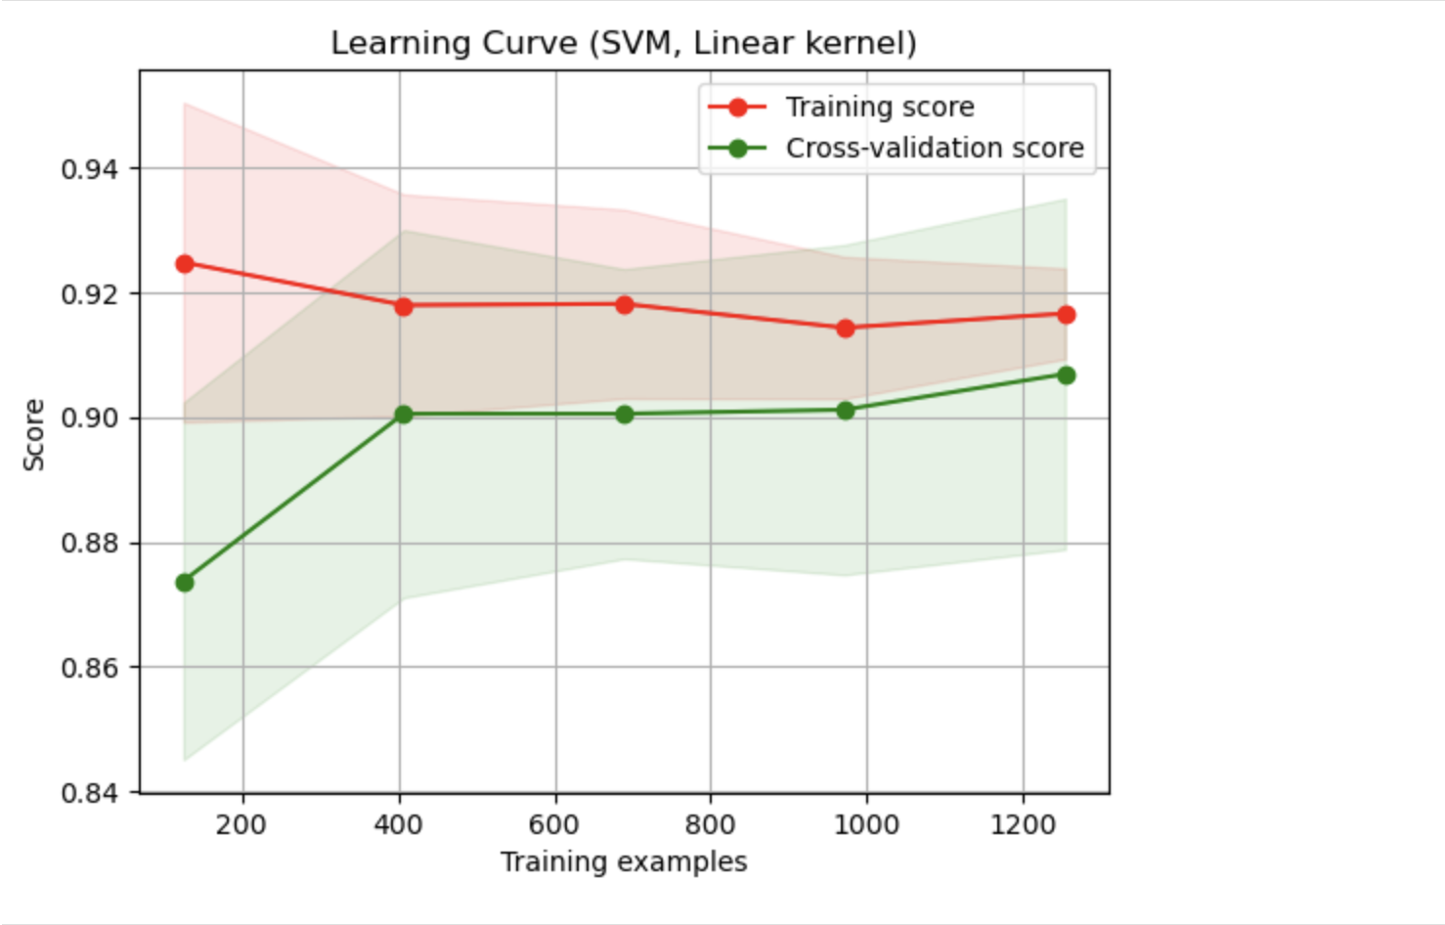
Cross validation
hyperparameter：PCA Variance
LEARN —— CURVE
The training score (red line) indicates that the model consistently performs well on the training set as more data is introduced, which suggests that the model has a good fit to the training data. The score remains relatively high across the board, demonstrating the model's solid learning capacity.
The cross-validation score (green line), which measures performance on data the model hasn't seen during training, improves significantly with more training examples. This upward trend is a sign that the model is learning generalizable patterns from the training data.
Looking at the gap between the scores, we see it's quite narrow, which implies that the model is generalizing well and is not overfitting to the training data.
Result: The model is learning effectively and is able to generalize from its training. There's a notable improvement in generalization as more training data is used. The plateau in improvement suggests that adding more data might not yield significant performance gains, possibly because the model has reached its learning capacity with the current complexity.
To improve further, it might be beneficial to explore increasing the model's complexity if it seems too simple. This could involve introducing more features, tuning hyperparameters, or experimenting with a different model architecture that can capture more complex patterns in the data.

Slide 16
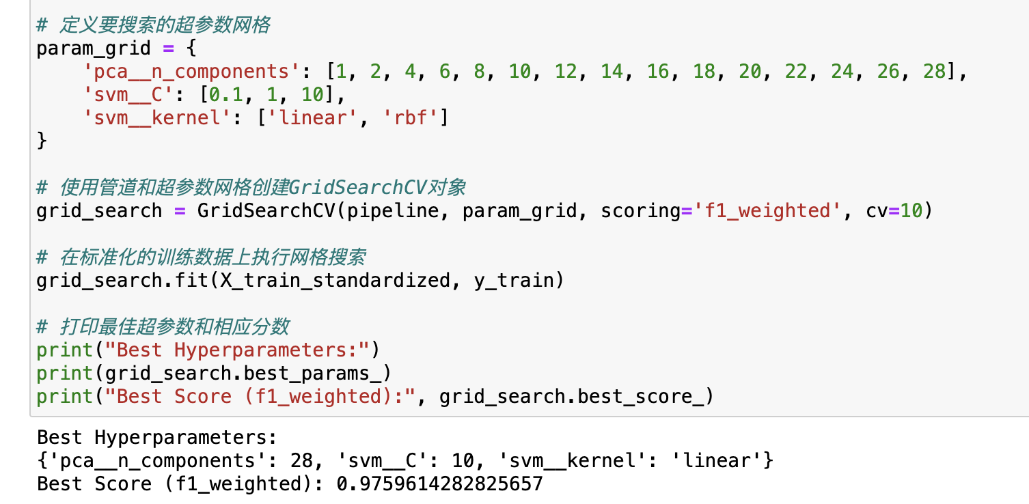
Cross validation
hyperparameter：PCA Variance
Grid-search → How many components we want

Slide 17
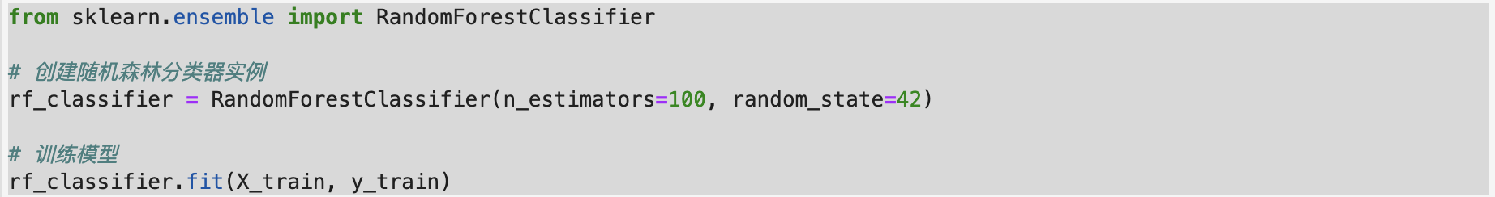
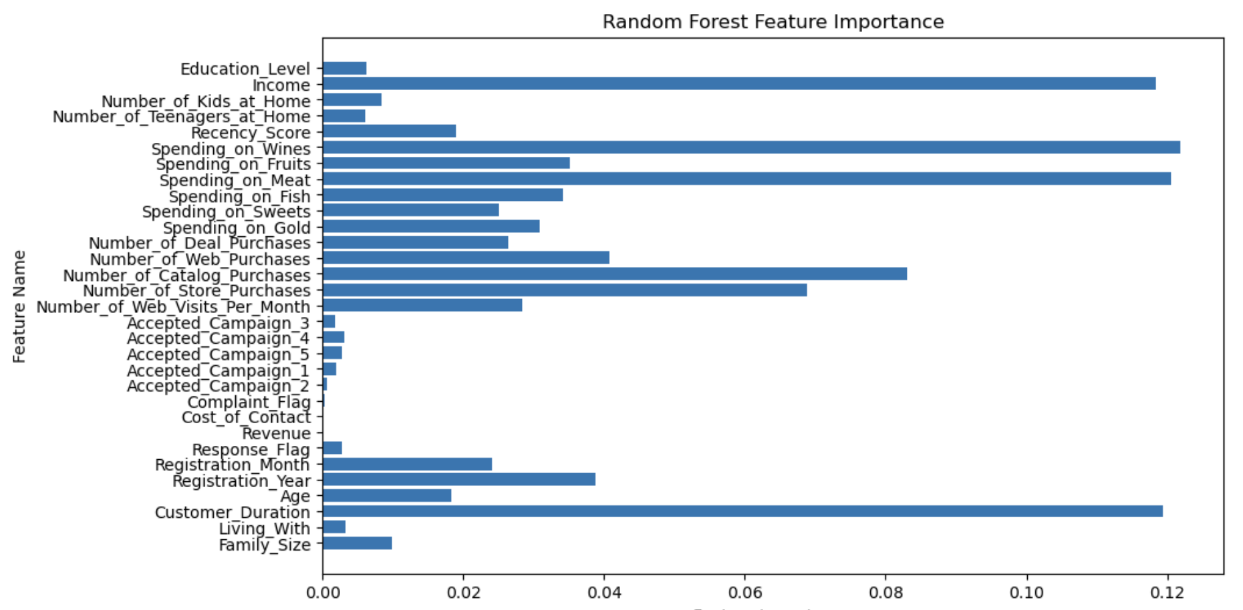
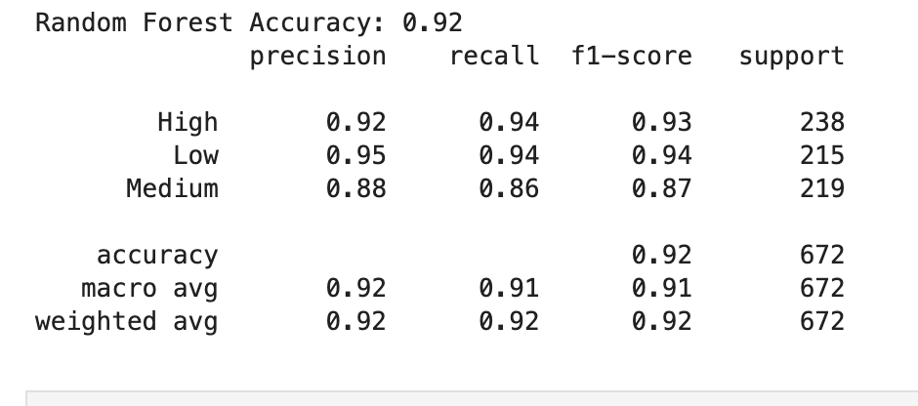
RandomForest
Presentation title
Training sets 70%
Testing sets 30%
Using train_test_split
Notes:
口头解释：PCA is an algorithm that does not consider the response variable / prediction target into account. PCA will treat the feature has large variance as important features, but the feature has large variance can have noting to do with the prediction target

Slide 18
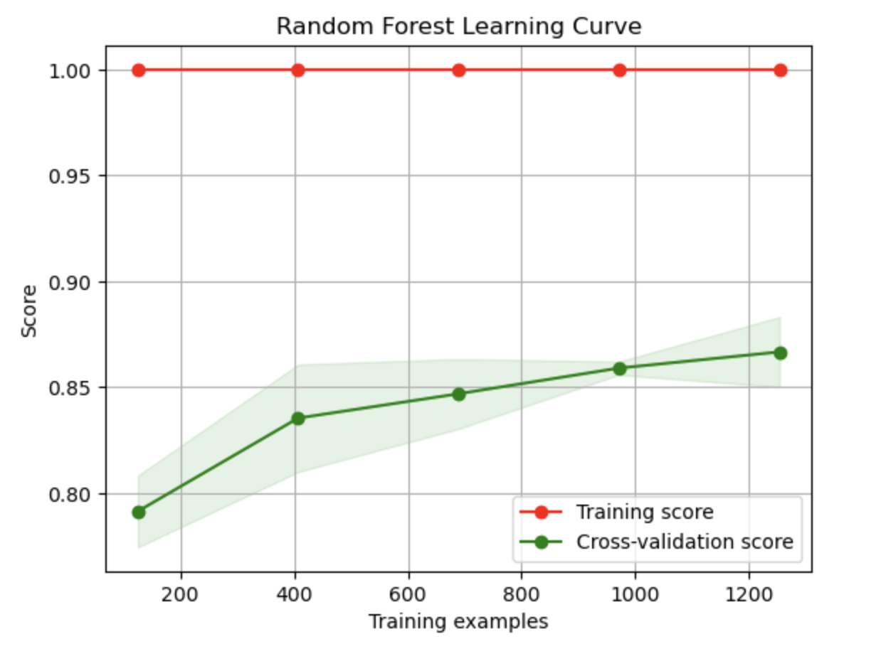
Based on the learning curve plot you've uploaded, we can observe several key points:
1. The training score (red line) is extremely high, almost reaching a perfect score (1.0).
2. The cross-validation score (green line) increases as the number of training samples grows but always remains below the training score.
3. There is a certain gap between the training score and the cross-validation score.
These observations suggest the presence of overfitting. This means that the model learns very well on the training data but does not perform as well on unseen data, such as the cross-validation set. Although the cross-validation score improves as the number of training samples increases, the rate of improvement slows down, and there is a significant gap compared to the training score. This may indicate that adding more data could help with the model's generalization ability, but the model might also need regularization or a simpler model structure to reduce overfitting.
Presentation title
RandomForest
Notes:
口头解释：PCA is an algorithm that does not consider the response variable / prediction target into account. PCA will treat the feature has large variance as important features, but the feature has large variance can have noting to do with the prediction target

Slide 19
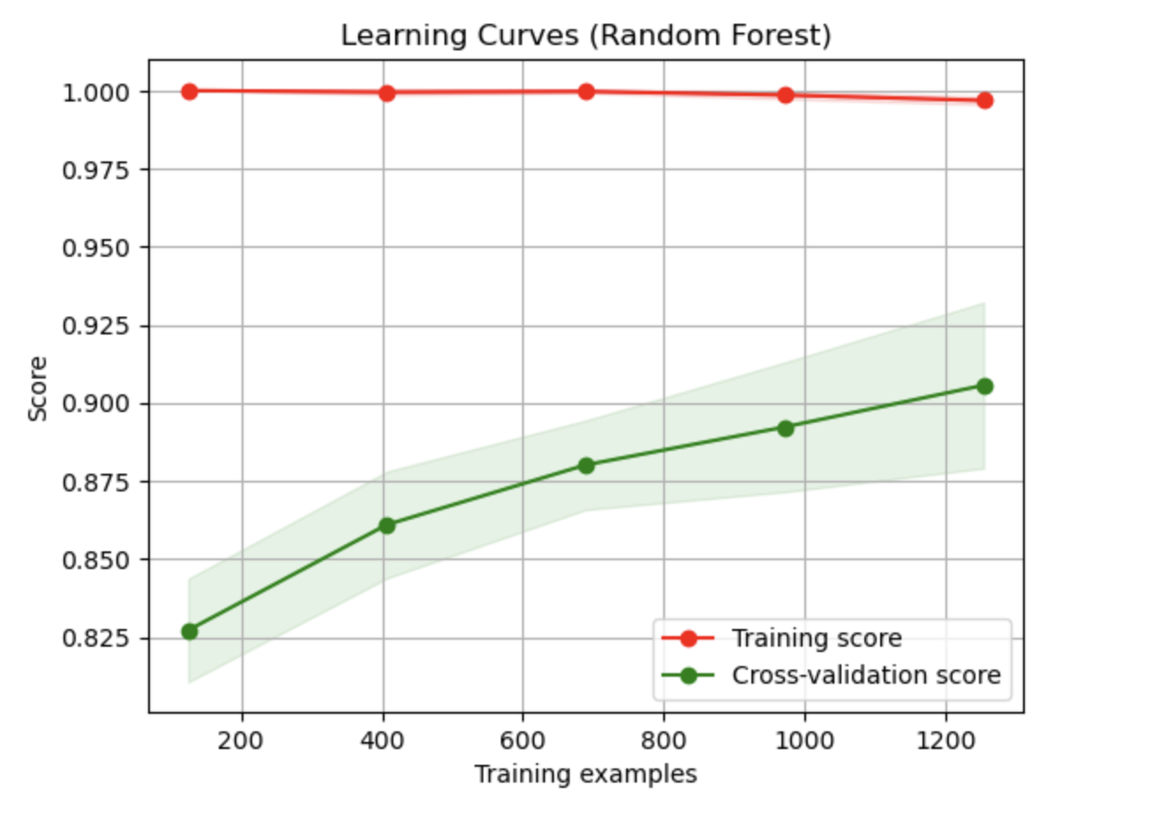
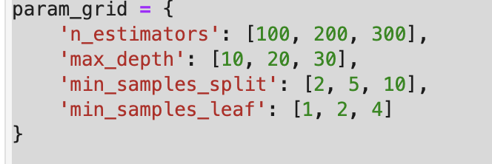
RandomForest
Presentation title
GET A LITTLE BETTER
Notes:
口头解释：PCA is an algorithm that does not consider the response variable / prediction target into account. PCA will treat the feature has large variance as important features, but the feature has large variance can have noting to do with the prediction target

Slide 20
Customer Analysis
Training and Results (unSupervised)
Feature extraction
Classic K-means and K-means with PCA
Customer segment preferences

Slide 21
Feature extraction
Customer Analysis
RFM model
Add more details (for goal: sales forecasting)
Recency (R)
Frequency (F)
Moentary value (M)
Engagement
Revenue
Notes:
Pre试需要口头解释：re是最近一次购买,eng是接受营销活动数量，Mon是消费数据,fre是购买频率,revenue是购买人的收入 （先说我们用了传统的用户分析模型 RFM，然后因为我们的数据很多，我的的目标是。。。所以又增加了两项数据，这两个数据分别代表什么 ¶（知乎解释：Recency（R）是客户最近一次购买日期距离现在的天数，这个指标与分析的时间点有关，因此是变动的。理论上客户越是在近期发生购买行为，就越有可能复购，此外R也涉及到了客户的获取，维持等方面，是非常重要的指标。
Frequency（F）指的是客户发生购买行为的次数--最常购买的消费者，忠诚度也就较高。增加顾客购买的次数意味着能占有更多的时长份额。
Monetary value（M）是客户购买花费的总金额。

Slide 22
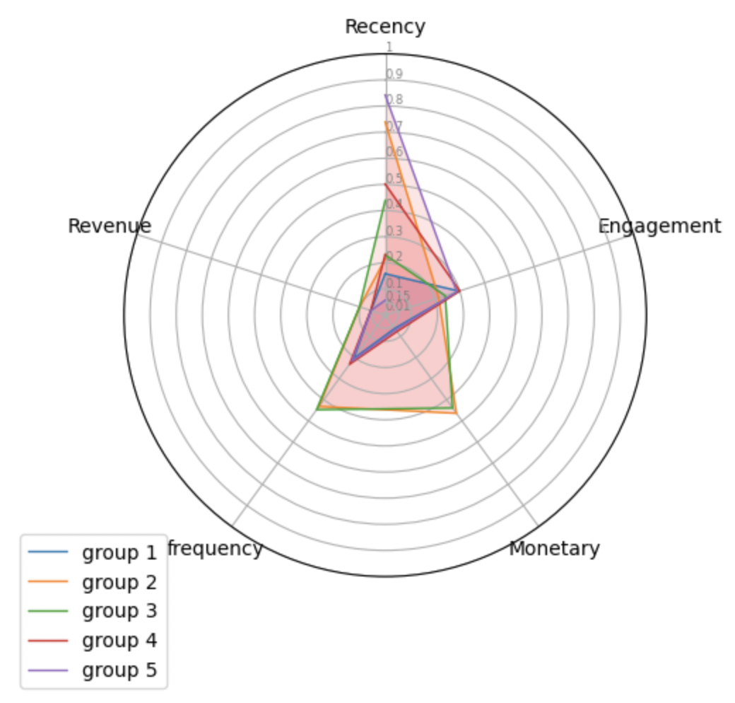
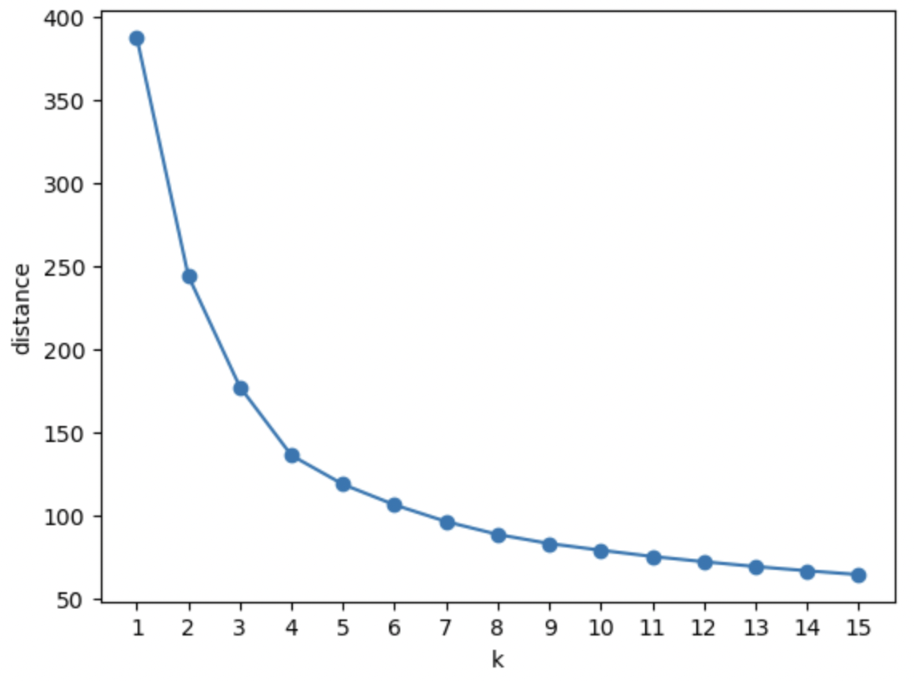
K-means
Customer Analysis
classic
→ K=5

Slide 23
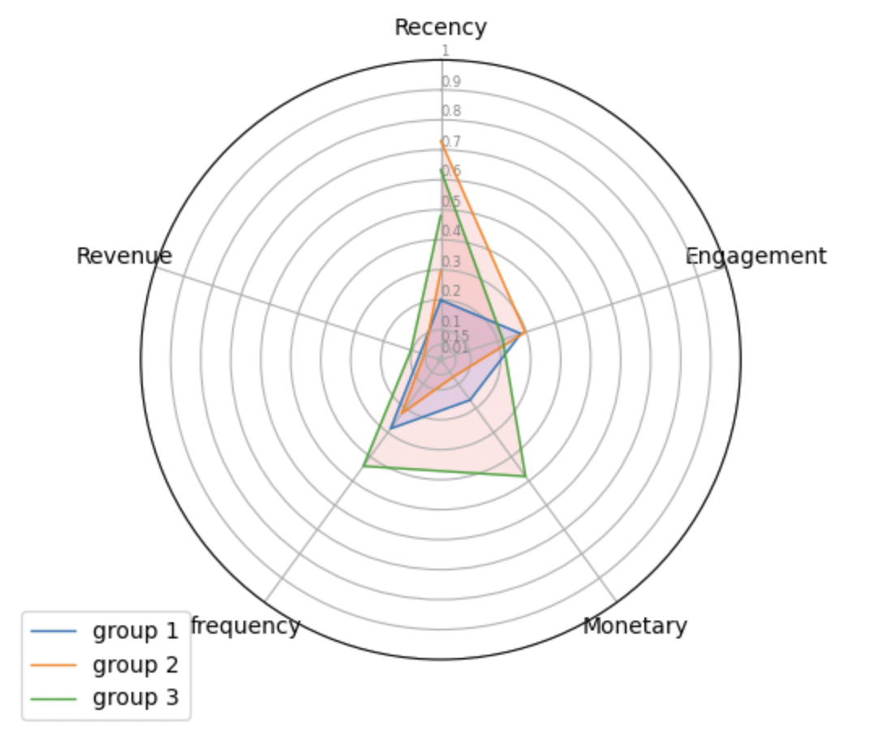
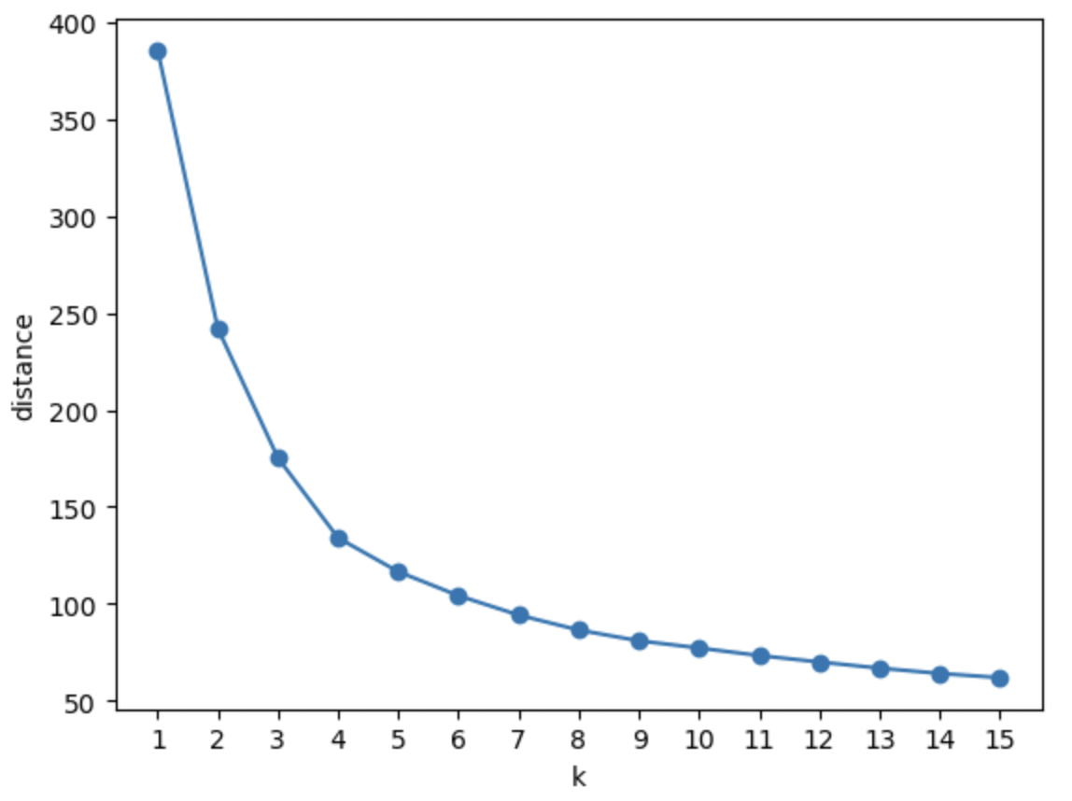
K-means
Customer Analysis
PCA (95%)
→ K=3
Notes:
说明时可以提到：所以簇中心与原来特征的数据不匹配所以我们需要手动计算 ¶（根据notes详细介绍一下一些处理，然后在讲一下得到的结果图）

Slide 24
Segment preference
Presentation title
Result analysis
Group 1: low income, long purchase interval
Group 2: middle income, more influenced by marketing
Group 3: high income, high shopping frequency
Campaign bias
Group 1: campaing 3, 4
Group 2: campaing 3, 4
Group 3: campaing 1, 5
All groups primarily spend their money on red wine and meat
Target features:
Accepted_Campaign_i, for i=1,…,5
Notes:
可以解释一下long purchase interval 是因为recency小。然后说为了营销策略我们又分析了用户对活动的偏好，（根据Accepted_Campaign_i这个特征），让营销活动广告更有针对行的投放到客户

Slide 25
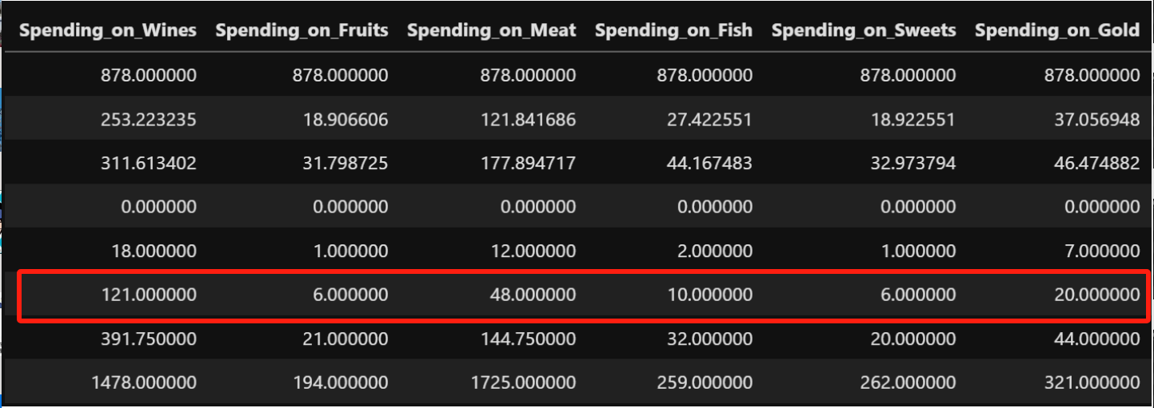
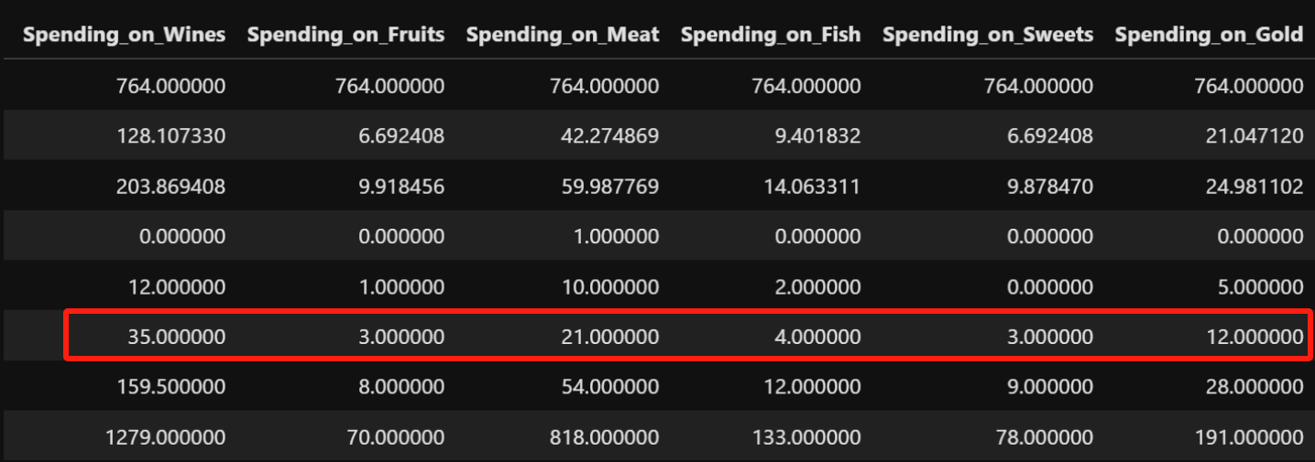
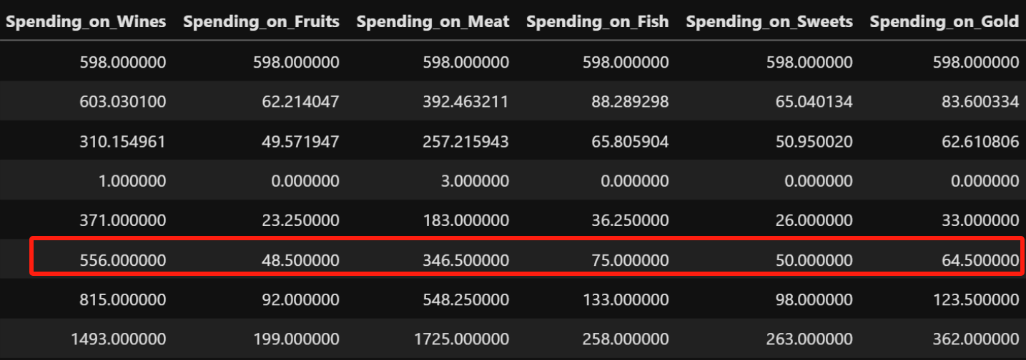

Slide 26
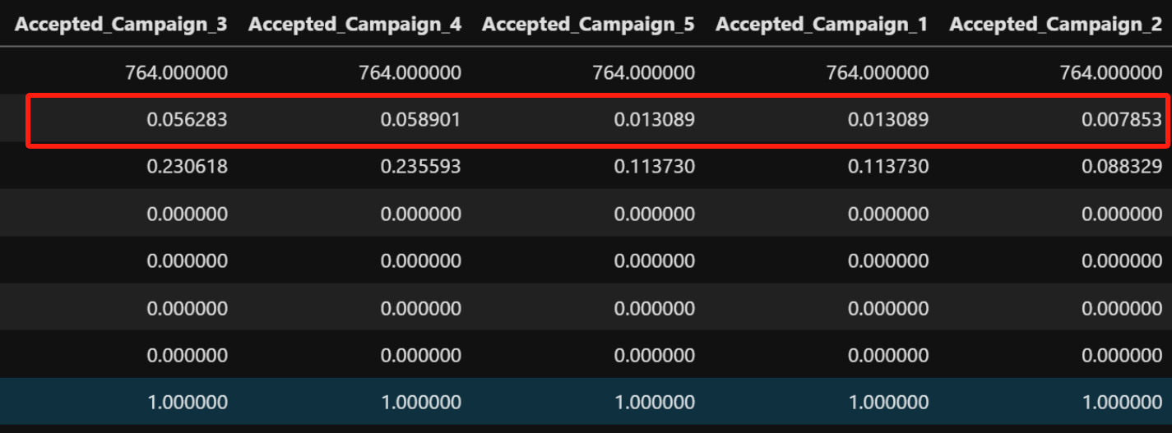
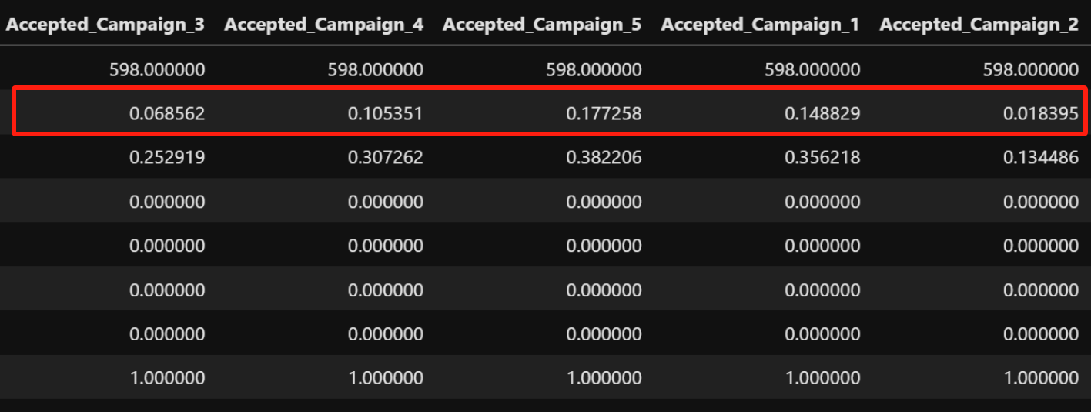
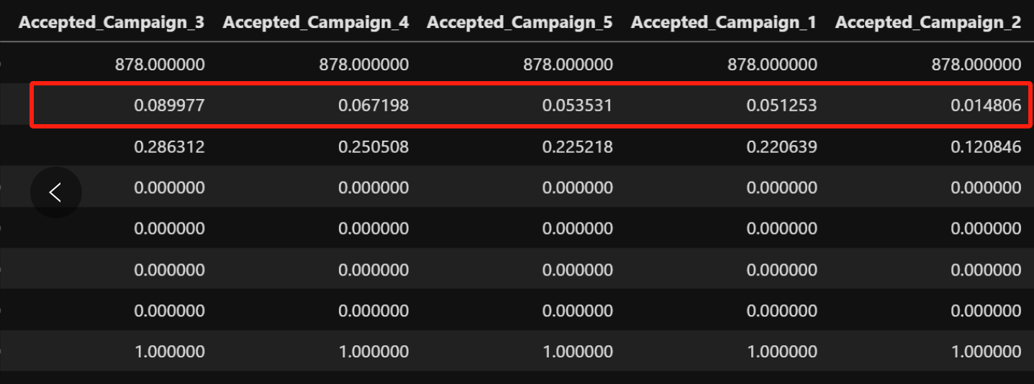

Slide 27
Conclusion
Customer Analysis
Learning
Further work

Slide 28
Customer Analysis
Learning
PCA, SVM, K-MEANS
Future work
LDA replaces PCA (classification problem)
Randomforest → Overfitting
Silhouette Coefficients are not good
Notes:
Silhouette Coefficients are not good，预处理or换方法？

Slide 29
Thank You

